Slide 1
Innovations in address-based sampling (ABS) for travel surveys
Christopher Coy, Mark Bradley, and Elizabeth Greene
June 4, 2019, TRB Planning Applications Conference

Slide 2
Presentation Overview
Survey-based data collection provides valuable, comprehensive travel behavior data to support modeling and planning
Who you sample can significantly impact your results and representativeness
There are many opportunities to leverage third-party data to improve address-based sampling plans for travel surveys
1
2
3
Better sampling allows for better modeling and analysis
Notes:
Survey-based data collection provides valuable, comprehensive travel behavior data.
“better” sampling plans depends on the project, but it can be both ‘more representative’ and
“Sampling” in data collection, by the way, is a process ‘big or passive’ data products go through as well, it’s just much less explicit, more opaque, and .

Slide 3
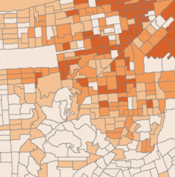
How participants are recruited into surveys drives what sample frames are viable. Most household travel surveys use ABS.
History to Present
IN-PERSON
TELEPHONE
ADDRESS-BASED (ABS)
RECRUITMENT: Door-to-door with in-person interviews
SAMPLE FRAME: List of all households or addresses
RECRUITMENT: Telephone (landline)
SAMPLE FRAME: List of all (landline) telephones
RECRUITMENT: Mailed/printed invitations
SAMPLE FRAME: List of residential addresses (USPS)
*These are all probability sample methods.

Slide 4
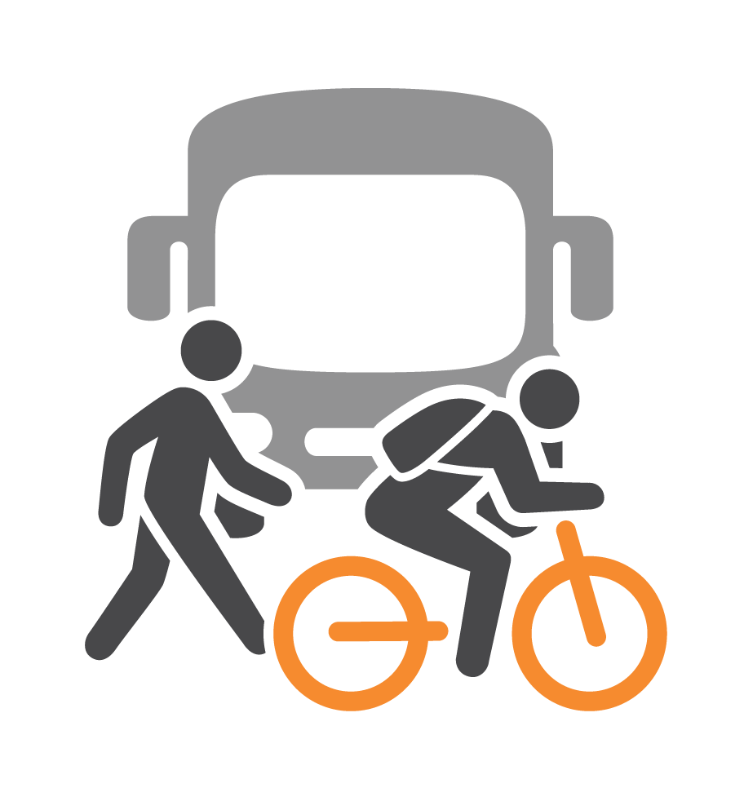
Let’s review 3 recent case studies on sampling methods.
1
Oversampling for bike, walk, transit users
To support modeling and analysis, we want more data for ‘rare’ or ‘new’ travel modes
Oversampling for TNC users
Overcoming income-based non-response in surveys
Low-income HHs are typically less likely to participate in surveys
2
3

Slide 5
CASE STUDY 1: Oversampling for bike, walk, & transit users

Slide 6
ABS travel surveys can oversample bike, walk, transit users.
Challenge
There is a persistent need to get more data for ‘rare’ or ‘new’ travel behaviors (transit, bike, walk, TNC, etc.)
Approach
Use American Community Survey (ACS) data to identify Census Block Groups where relatively more bike, walk, or transit commuters live
→ Oversample those areas

Slide 7
Data from San Diego County shows how geographic concentration of bike, walk, and transit commuters.
Notes:
This distribution is typical of many regions. Sampling at the block group level is most efficient at oversampling for these users.

Slide 8
This approach is effective to get more walk, bike, transit users. The degree of oversampling determines how much more.
Benefits
Limitations
It works! Can often get 2–3x the unweighted data for given populations
2x the data for rare behaviors can really reduce margins of error for small groups
This is neutral (or helps) overall response rates and can save project budget
Still a probability sampling approach, with all the statistical benefits
Aggressive oversampling leads to geographically lumpy data (but that also reflects reality)
Oversampling leads to higher variance (less precision) in the overall weighted sample (but likely more precision for bike/walk/transit users)
Notes:
Results are somewhat lumpy, but the final weighted dataset is still representative.
This has the effect of increasing variance in the final, weighted dataset (which is a tradeoff), but increases unweighted sample sizes for these behaviors.
More data → more precision → the potential to go from statistically insignificant to significant results. That can be a really big deal.

Slide 9
CASE STUDY 2: Oversampling for TNC Users

Slide 10
To oversample TNC users, RSG is using a model based upon ACS and prior household travel survey data.
Data Source 1: ACS data at the block group level
Data Source 2: San Diego Regional Transportation Study
2016–17 household travel survey for SANDAG
Included TNC as a travel mode → Captured 1,700 TNC trips from 630 people
Largest known TNC trip count in a household travel survey
Predictive model:
The model estimates the average TNC trips per household in that block group
Model variables include: income, presence of children, age, block group density, number of vehicles, and more
Notes:
[]

Slide 11
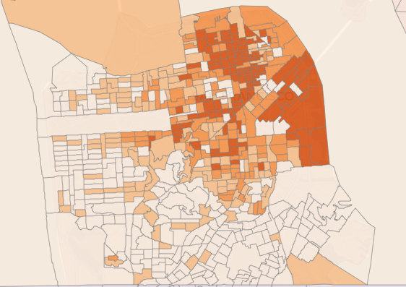
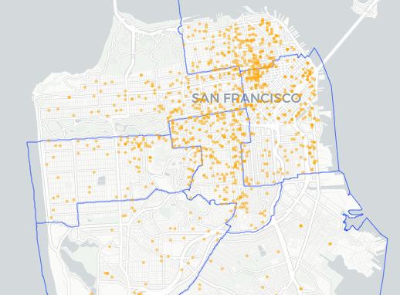
After identifying areas where more TNC-using residents live, we invite more households from those neighborhoods.
Model where TNC users live → Heavy Oversampling
Obtain more participants who live in those Block Groups
Darker-shaded Block Groups had higher expected TNC use and received higher invitation rates.
As expected, more participants are coming from oversampled areas.*
*Maps shown are for San Francisco. The location points are ‘jittered’ by adding random noise.
Notes:
We take ACS data and model which block groups will have residents that are more likely to use TNC? This model is based upon SANDAG HTS data.
We invite more households from those block groups/neighborhoods, increasing participation from those households/persons.
(Next slide shows how well this stratification is working).
We did have troubles with this early on. Response rates were low, very low, but the mailing/recruitment approach was revised and negative external factors seem to be fewer.

Slide 12
ABS oversampling for TNC users is very effective. It’s scalability/impact depends on the region’s level of TNC use.
Sample Region | Sample Strata | % self-described ‘TNC Users’ | TNC mode share | ‘Shared mobility’ mode share (car/bike/scooter)
San Francisco County | Very High TNC | 62% | 7.2% | 1.5%
 | High TNC | 58% | 5.1% | 1.6%
 | Medium TNC | 45% | 3.1% | 0.3%
 | General Population | 47% | 1.9% | 0.3%
 | Subtotal | 57% | 5.5% | 1.3%
8-County Region | Very High TNC | 43% | 2.0% | 2.1%
 | High TNC | 64% | 2.7% | 1.9%
 | Medium TNC | 51% | 1.9% | 0.9%
 | General Population | 31% | 0.7% | 0.4%
 | Subtotal | 45.0% | 1.6% | 1.0%
 | Total | 52.1% | 3.9% | 1.2%
Persons completing survey in 2018*
313
209
97
53
672
47
97
148
181
473
1,145
*Based upon a draft dataset of 1,145 persons who completed the Bay Area TNC study in 2018. All survey figures unweighted.
Notes:
Things to call out:
The TNC mode shares are scaling well with the oversampling. It’s working.
The low TNC mode share in the general population does
The scalability of this approach is essentially constrained by the reality of TNC use in each area.
The SF distribution of High vs Low TNC use (two-thirds of HHs live in a high-TNC area) is the inverse of the Eight-County Region (only 9% lives in a TNC oversample area).
We’re getting a relatively high Percent of people taking TNC trips, compared to the % who are self-described TNC users.
In the San Diego HTS< only ~2% of BGs qualified as Very High TNC, with another 6% of BGs as High TNC.
We’re getting about the right share of people taking TNC trips as say they take TNCs, at least in the high-frequency strata and from high-frequency users. The issue is getting TNC trips from rare users, which is most of the TNC-using population.

Slide 13
This approach is effective at getting more ‘local’ TNC users.
Benefits
Limitations
It works! Not a lot of other (good) options for sampling TNC users
Captures more self-described and actual TNC users
Slightly helps response rates, compared to the general population
Still a probability sampling approach, with all the statistical benefits
Geographically lumpy data (but that also reflects reality)
Most TNC users are infrequent users, meaning data collection/diary methods matter a lot for capturing TNC trips
Doesn’t capture TNC use from visitors, who likely use TNCs a lot
Notes:
Results are somewhat lumpy, but the final weighted dataset is still representative.
This has the effect of increasing variance in the final, weighted dataset (which is a tradeoff), but increases unweighted sample sizes for these behaviors.
More data → more precision → the potential to go from statistically insignificant to significant results. That can be a really big deal.

Slide 14
CASE STUDY 3: Overcoming income-based non-response

Slide 15
RSG has used third-party household income data to help overcome income-related non-response bias.
Challenge: Low-income households are less likely to respond to surveys, and income is a key determinant of travel behavior
Approach: Use 3rd-party estimated household income (e.g., credit agency data) to send relatively more invitations to low-income households
RSG gets this income data from our ABS data provider (MSG)
Typically 80–90% of households have an estimated income, 10–20% don’t
HH ID | Address | City | State | Zip Code | Estimated HH income
1 |  | WEST SACRAMENTO | CA | 95691 | $50,000-$74,999
2 |  | SACRAMENTO | CA | 95828 | $35,000-$49,999
3 |  | SACRAMENTO | CA | 95823 | $75,000-$99,999
4 |  | SACRAMENTO | CA | 95828 | NA
… |  | … | … | … | …

Slide 16
To help overcome non-response bias, a project can sample-but-not-invite medium and higher income households.
Benefits
Limitations
It works!
Other options for this are more geographically lumpy
This approach is scalable and changeable
Scalable: Degree of oversampling can be dialed up or down easily, based on budget
Changeable: If you need to scale back or undo part way during sampling, you can
Still a probability sampling approach, with all the statistical benefits
By its nature, this approach invites more people who are ‘hard-to-reach,’ lowering survey response rates
Lower response rates lead to higher sampling/recruitment budgets
Notes:
Results are somewhat lumpy, but the final weighted dataset is still representative.
This has the effect of increasing variance in the final, weighted dataset (which is a tradeoff), but increases unweighted sample sizes for these behaviors.
More data → more precision → the potential to go from statistically insignificant to significant results. That can be a really big deal.

Slide 17
Concluding Thoughts

Slide 18
Concluding Thoughts
Travel behavior is changing. We need to ensure that our data collection and sampling methods keep up
The concepts of representativeness and data quality should apply to all data products (including passive/big data)
There are opportunities to use third-party data (including other travel survey data) to improve travel survey sampling
These methods are viable, effective, continually improving, and in use today

Slide 19
Christopher Coy
Senior Consultant
Christopher.Coy@rsginc.com
Elizabeth Greene
Director
Elizabeth.Greene@rsginc.com
Mark Bradley
Senior Director
Mark.Bradley@rsginc.com

